Slide 1
Digital Portfolio
STUDENT NAME: A. Asberbanu
REGISTER NO AND NMI:24134110500122005 DA4ACB2DCC018182C54A6A8(asanm41124134110500122005)
DEPARTMENT: BCA-Bachelor of computer application
COLLEGE: COLLEGE/ UNIVERSITY:Vivekananda college/Annaamalai university

Slide 2
Project title
Digital student portfolio

Slide 3


AGENDA
Problem Statement
Project Overview
End Users
Tools and Technologies
Portfolio design and Layout
Features and Functionality
Results and Screenshots
Conclusion
Github Link
3/21/2024 Annual Review

Slide 4

PROBLEM STATEMENT
**In the current digital era, students and professionals struggle to effectively showcase their skills, achievements, and growth beyond traditional resumes and certificates.
**Static documents fail to reflect creativity, real-time progress, or interactive content.
This platform should allow:- Uploading multimedia (images, videos, documents)- Linking to external content (e.g., GitHub, LinkedIn)- Customizable templates
Using statement
- Allowing students to showcase their info (HTML) - Styling it cleanly (CSS) - Making it interactive (JavaScript)

Slide 5

PROJECT OVERVIEW
The portfolio allows:- Adding personal details and goals
- Uploading project descriptions and certificates
Styling the content with HTML and CSS
Adding interactivity using JavaScript
(e.g., add/remove projects)It helps students present their profile professionally to teachers, colleges, or recruiters. The main goal is to provide a simple, smart, and organized way for students to build their digital identity.

Slide 6

WHO ARE THE END USERS?
*Students* – To create, manage, and share their portfolio showcasing skills, projects, and achievements.
*Teachers/Lecturers* – To review students' work and track academic progress.
*Recruiters/Employers* – To assess student capabilities during internships or job hiring.
*College Admission Teams* – To evaluate applicants beyond grade and certificates.
*Mentors/Guidance Counselors* – To help students improve and guide their learning path.
*Parents/Guardians* – To view their child’s growth and academic achievements.

Slide 7

TOOLS AND TECHNIQUES
Tools and Techniques Used in Student Portfolio Project:
*HTML* – To create the structure and content of the portfolio.
*CSS* – For styling, fonts, layout, and visual design.
*JavaScript* – For adding interactivity (e.g., buttons, forms).
*Code Editor* – Like VS Code or Sublime Text.
*Browser* – Google Chrome, Firefox (for testing).
*GitHub (optional)* – To host and share the portfolio online.
*Techniques:*
*Responsive Design* – Making the portfolio work on both mobile and desktop
2. *Form Handling* – Collecting user input like project details or feedback.

Slide 8
POTFOLIO DESIGN AND LAYOUT
*🔷 Layout Structure:
*1. *Header* - Name, title (e.g., “Web Development Student”) - Navigation bar (Home | About | Skills | Projects | Contact)
2. *About Me Section* - Short bio - Educational background - Career goals
3. *Skills Section* - List of technical and soft skills - Icons or progress bars (optional)
4. *Projects Section* - Project title, description, and links - Screenshots or demos (optional)
5. *Certificates Section* - Upload/view academic and course certificates
6. *Contact Section* - Email ID, phone number, or contact form
7. *Footer* - Social media links (LinkedIn, GitHub)*
🖌️ Design Guidelines:*
Use consistent fonts and colors* (e.g., blue & white theme)
*Keep it responsive for* mobile and desktop.
*Use cards or grids* to display skills/projects neatly.
*Highlight key information* with headings and icons.
8

Slide 9
FEATURES AND FUNCTIONALITY
Features
1. *Personal Profile Section* – Name, photo, contact info, education.
2. *Project Showcase* – Display academic or personal projects with descriptions.
3. *Skills Section* – List of technical and soft skills.
4. *Certificate Upload* – Option to show certifications or achievements.
5 *Responsive Design* – Works on mobile, tablet, and desktop.
Functionalities
*Add/Edit/Delete Projects* – Users can manage project entries.
*Interactive Buttons* – For submitting forms or showing more content.
*Dynamic Content Update* – Add new sections using JavaScript.
*Form Validation* – Ensures proper input before saving.

Slide 10
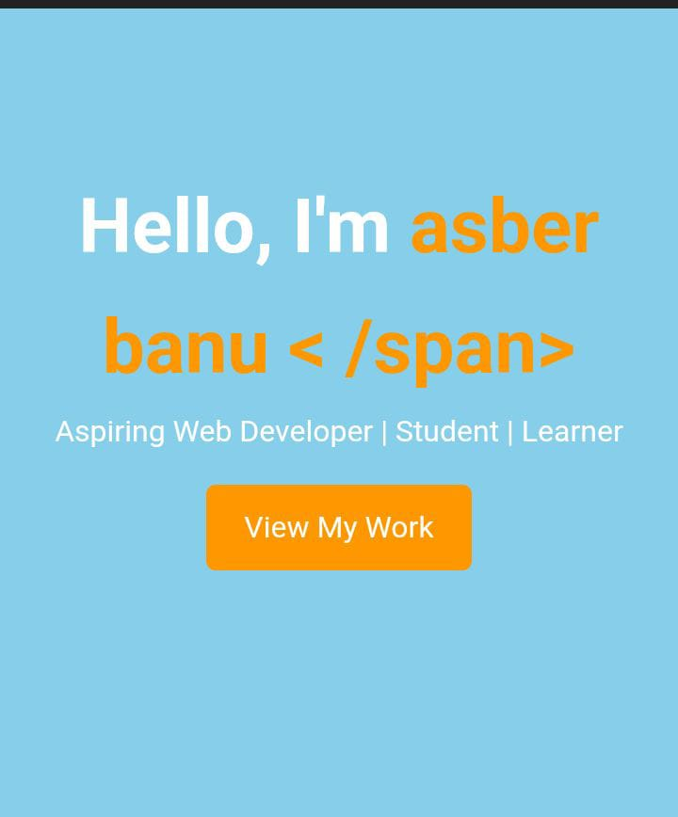
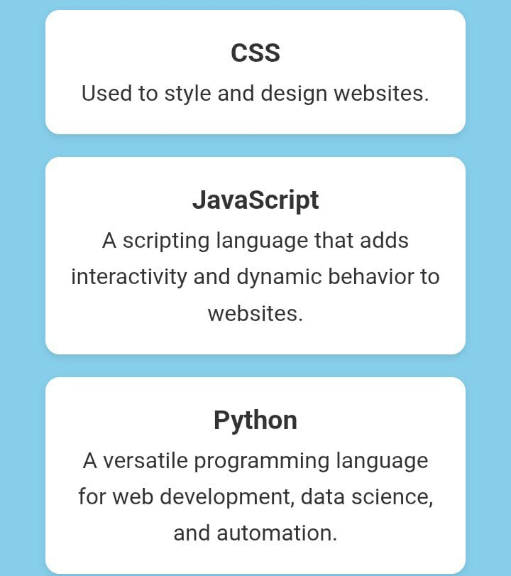

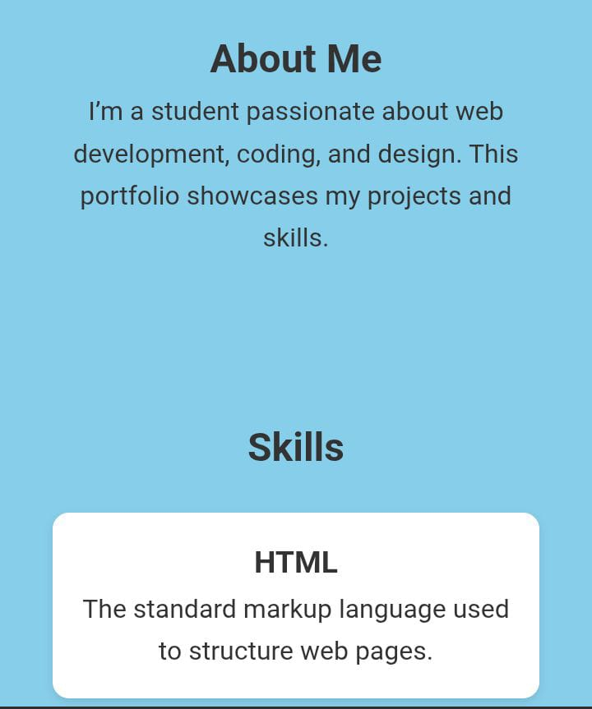
RESULTS AND SCREENSHOTS
3/21/2024 Annual Review
10

Slide 11
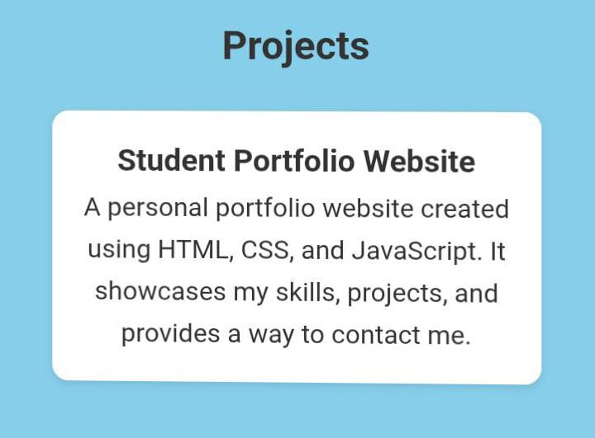
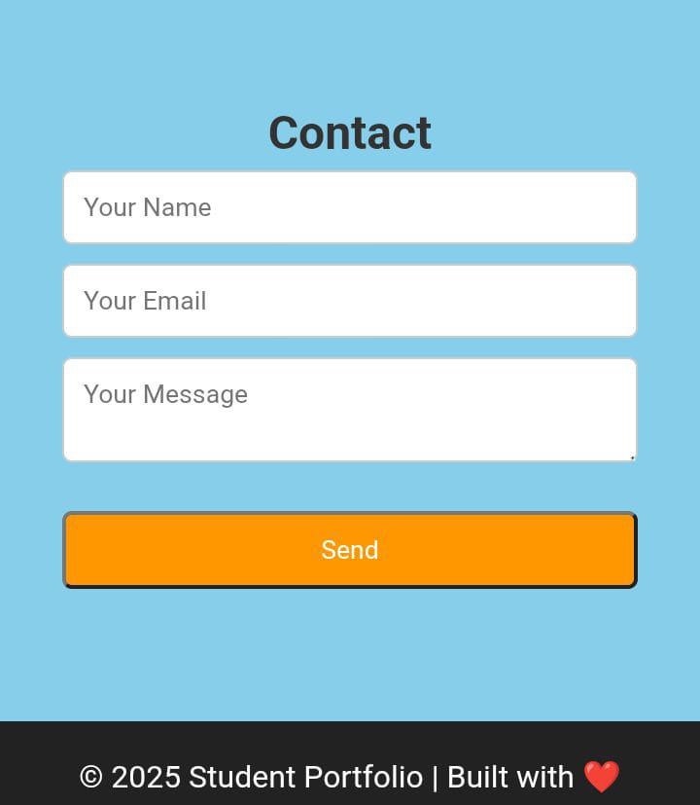

Slide 12
Githublink
https://github.com/asberat78-hue/Asber-Banu-TNDC-FWD-D-P.git

Slide 13
CONCLUSION
The *Student Portfolio project* successfully demonstrates how HTML, CSS, and JavaScript can be used together to build a clean, interactive, and responsive digital profile.
- *HTML* was used to create the structure and organize content such as about, skills, and projects.
- *CSS* enhanced the appearance through fonts, colors, layout, and responsive design.
- *JavaScript* added interactivity, such as adding projects or handling user actions.
13

